Slide 1

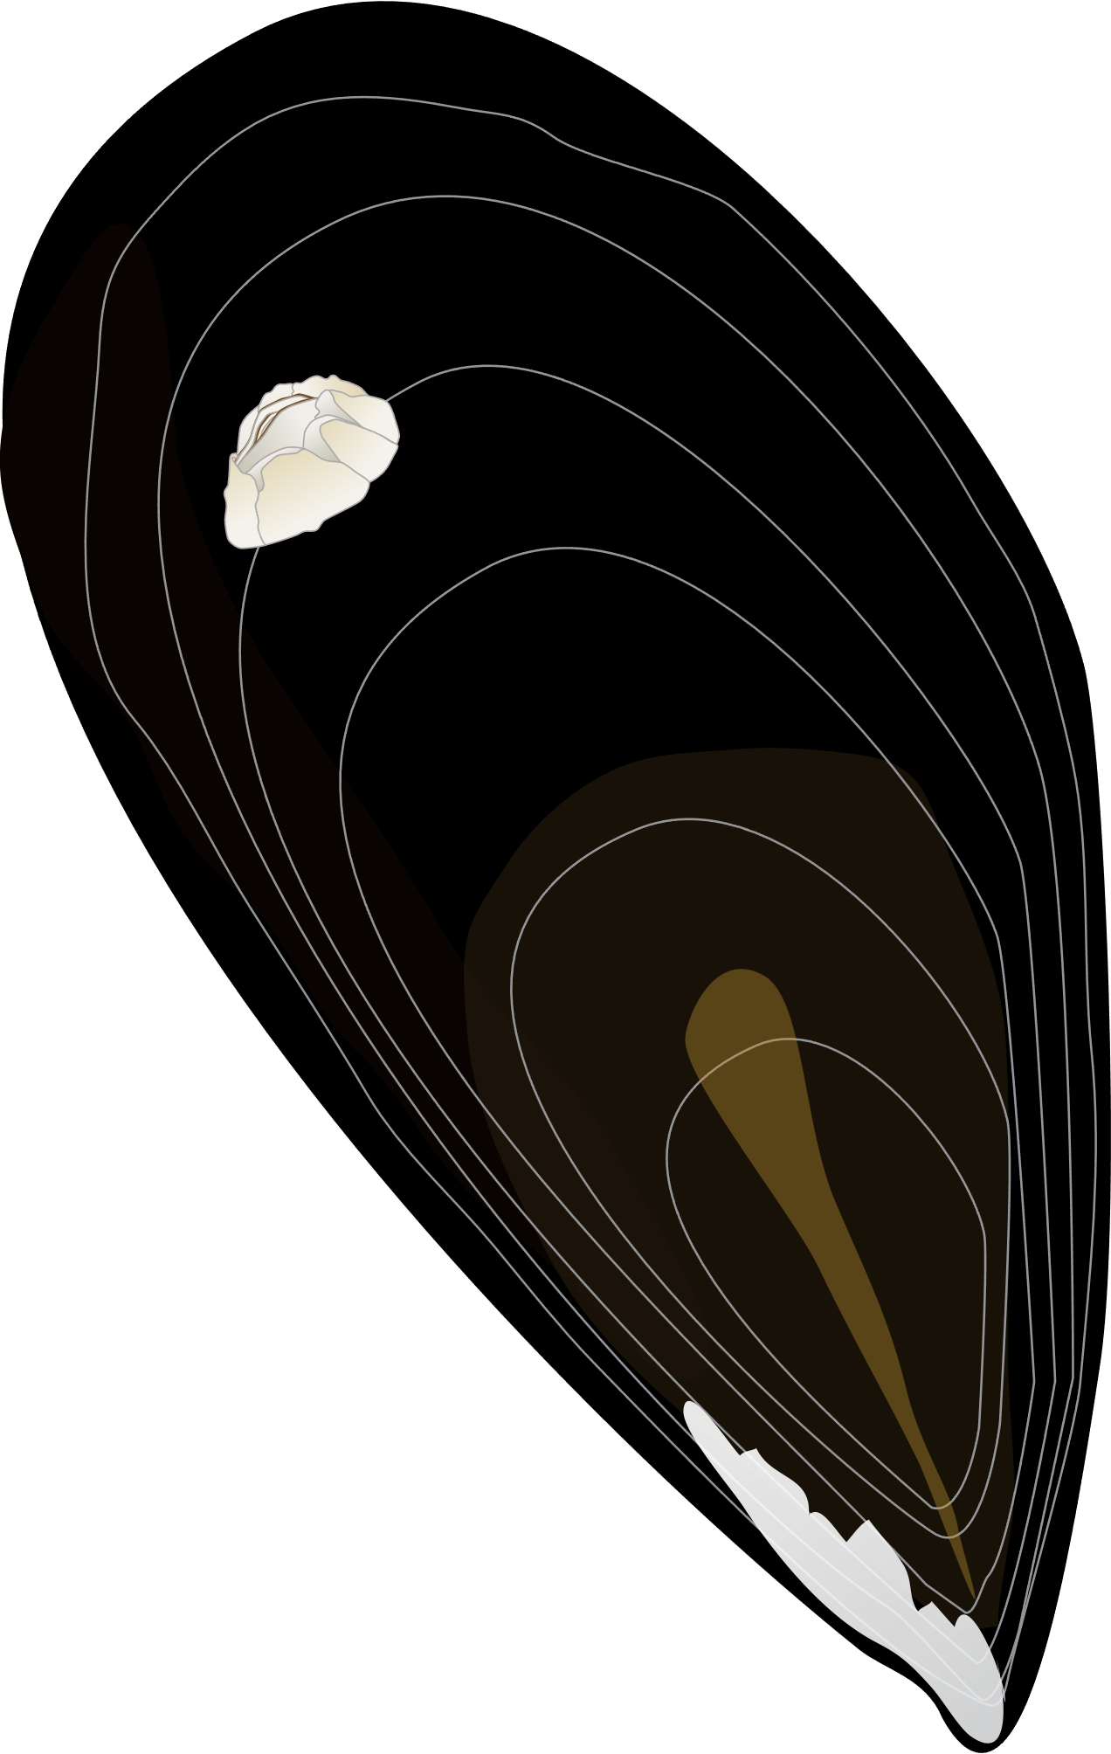
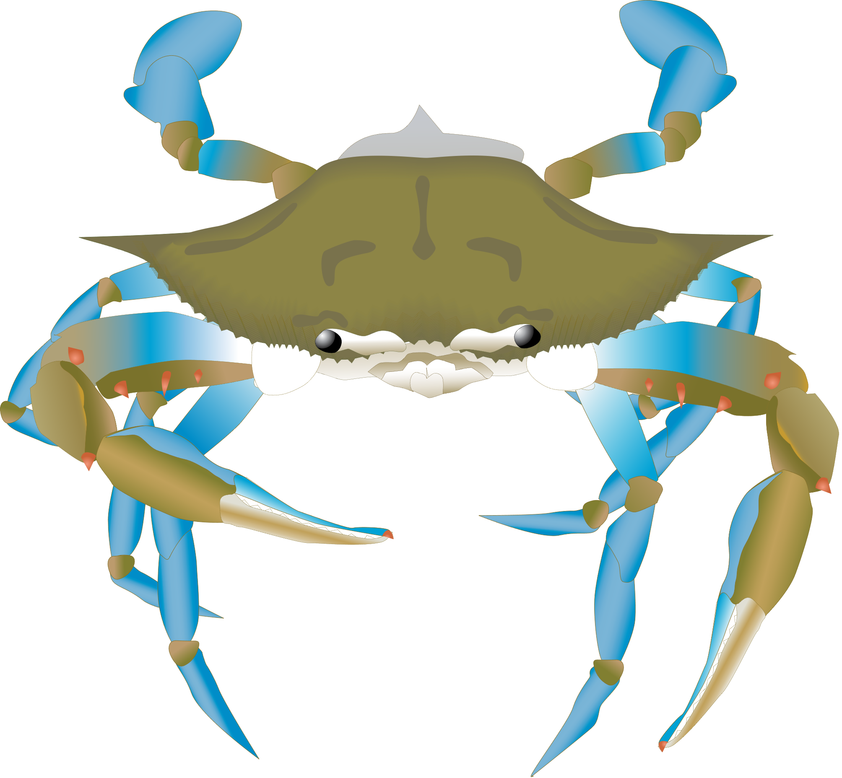

Blue crab cue
Mussels + blue crab cue
No blue crab cue
Mussels only
Blue crab cue
48 h
24 h

Slide 2

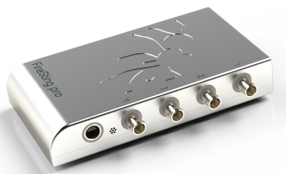
O2
Time
20°C
Exp. 1
Exp. 2
Exp. 3
Control
Pyro Science O2
x 4

Slide 3
Blue crab cues
Blue crab cues
24 h
24 h
Blue crab Callinectes sapidus
Mean carapace width : 13.6 ± 1.2 cm
Sex : males only
Organisms starved 24 h before
Aquarium volume : 15 L
Mussels Brachidontes pharaonis
3 sizes tested separately : small, median, large
Aquarium volume : 15 L

Slide 4
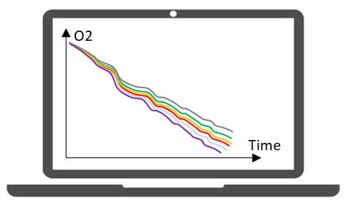
Blue crab cues
24 h
❶ 1 week of acclimatation at
13°C, 20°C, 27°C
❷ Exposition
°C
°C
°C
Crab cues
Mussels + blue crab cue
24 h
°C
°C
°C
No crab cues
Mussels only
24 h
3 size classes (small, medium, large)
❸ Respiration measurements
°C
Pyro Science O2

